Slide 1

The Dos and don’ts of dashboard reporting
Avi Skidelsky

Slide 2

Topics:
Why dashboards/viz?
What makes a good dashboard?
What makes a bad dashboard?
Tips for design
Ethics in reporting

Slide 3

Why visualizations?
Easy to convey information
Memorable
Easy to read
Not everyone is data literate

Slide 4
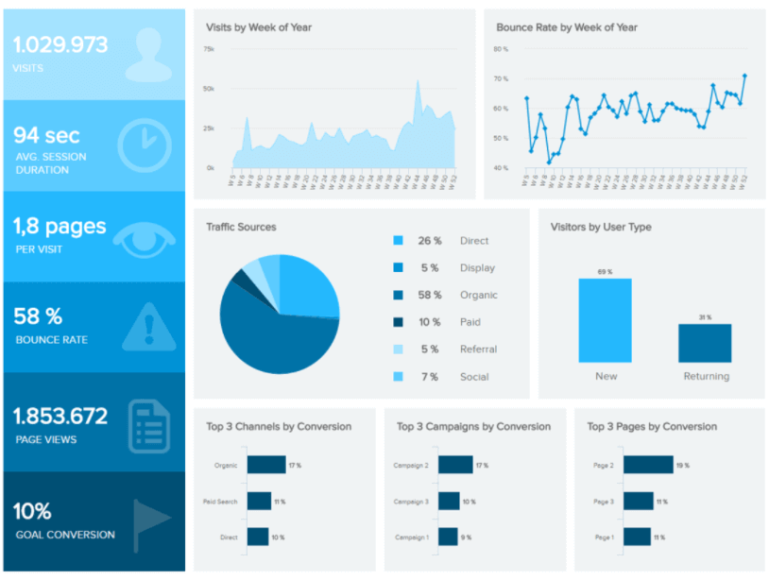
What makes a good dashboard?
Well organized
Can read at a glance
Quick statistics
Memorable
Source: https://www.datapine.com/blog/great-dashboard-design-examples-for-inspiration/

Slide 5
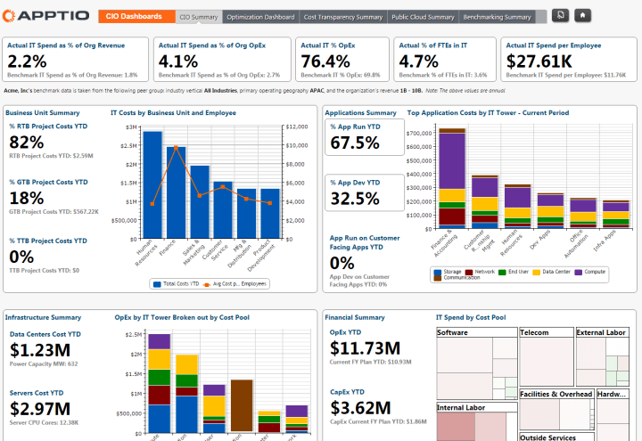
What makes a bad dashboard?
Hard to read
Granular
Messy
Complex
Requires data literacy
Source: https://carmel.es/2018/10/26/6-examples-of-bad-dashboard-designs/

Slide 6

Good design tips:
Your dashboard should be able to provide relevant information in 5 seconds or less
Define the purpose of the dashboard
Choose the right representation
Be consistent
Don’t rely on interactions
Design the dashboard last
Less is more
Sources:
https://uxplanet.org/10-rules-for-better-dashboard-design-ef68189d734c
https://www.sisense.com/blog/4-design-principles-creating-better-dashboards/

Slide 7
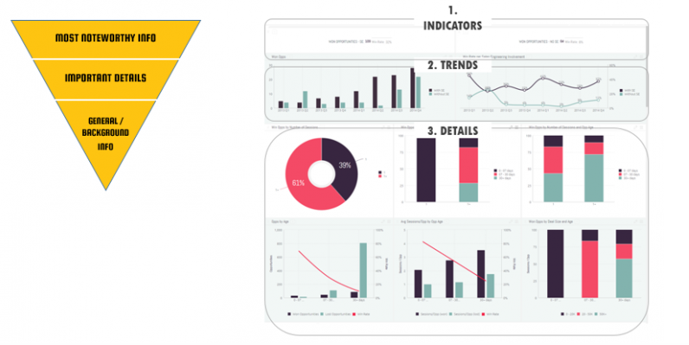
Logical layout
The reverse pyramid
Source: https://www.sisense.com/blog/4-design-principles-creating-better-dashboards/

Slide 8
Ethics in data reporting
Four main rules:
Fairness: all information should be treated equally and with objectivity
Privacy: show information only to those who need to see it, rule of least privilege
Transparency: information shouldn’t be hidden; everything should be available to see
Accountability: you should take responsibility for the insights shown in the dashboard, even if you’re not the data owner
Source: https://www.cognizant.com/us/en/glossary/data-ethics

Slide 9

All sources
https://www.datapine.com/blog/great-dashboard-design-examples-for-inspiration/
https://carmel.es/2018/10/26/6-examples-of-bad-dashboard-designs/
https://uxplanet.org/10-rules-for-better-dashboard-design-ef68189d734c
https://www.sisense.com/blog/4-design-principles-creating-better-dashboards/
https://www.cognizant.com/us/en/glossary/data-ethics

